Slide 1
REST API
Notes:
So what is .NET?

Slide 2
REST(ful)
REST
architecture type that’s using the existing web infrastructure
RESTful
services that implement REST architecture
Web resources – identified with URL address
HTTP verbs
GET, POST, PUT, DELETE, PATCH…
JSON or XML
Strict and pragmatic approach

Slide 3


HTTP REST CRUD
C
R
U D
Http POST routing + payload
201 + location
Http GET routing
200 + payload list
Http GET routing/{id}
200 + payload
Http PUT routing/{id}
200
Http DELETE routing/{id}
200

Slide 4
HTTP REST CRUD
1xx: Information
2xx: Success
3xx: Redirection
4xx: Client Error – You did screw up
5xx: Server Error – I did screw up

Slide 5
Additional ASP.NET Core Benefits for REST APIs
Endpoint routing - defining URLs
Support for HTTP verbs
Model binding
Content negotiation (JSON, XML, …)
Middleware / action filters
OAuth 2.0 support

Slide 6
Additional ASP.NET Core Benefits for REST APIs
Conventions
[ApiController]
ActionResult<T>
Convention definitions
Roslyn analyzers
Swagger support
SPA authentication with Identity Server

Slide 7
Production-ready APIs?

Slide 8
Best practices
IActionResult, ActionResult<T>
View Models
Model / input validation
Exception handling
Logging
Paging

Slide 9
Security
HTTPS
OAuth 2.0
JWT token based authentication
Identity Server 4.0
https://identityserver.io/
Third party
Auth0 - https://auth0.com/
Okta - https://developer.okta.com/
…

Slide 10
Testing
Unit testing
Integration testing
Manual testing
Tools (Postman, Fiddler, …)
Stress / load testing
https://loader.io/
https://artillery.io/
https://gatling.io/
http://websurge.west-wind.com/

Slide 11
Documentation
http://swagger.io/ -> https://www.openapis.org/
Swagger -> Open API Specification 3.0
API framework
Docs
Define an API
Automate API testing
Code generation
...
API Analyzers - Microsoft.AspNetCore.Mvc.Api.Analyzers
Swashbuckle or NSwag and Swagger UI

Slide 12
Usage limiting
Limit per token
With middleware or action filter
https://github.com/stefanprodan/AspNetCoreRateLimit
Limit per Client IP
Limit per Client ID header

Slide 13
Versioning
URL, also with namespacing
/api/v2/games/
Query string
/api/games?api-version=2
Custom request header
api-version: 2
Accept header
Accept: application/json;v=2
Microsoft.AspNetCore.Mvc.Versioning
Supports all types, query string by default (?api-version=2)

Slide 14
Monitoring
Simple logging – errors, logs
Performance tracking
Usage tracking
Azure – Azure Monitor, Application Insights, Log Analytics …
ASP.NET Core Health Checks
https://github.com/Xabaril/AspNetCore.Diagnostics.HealthChecks/
Third-party monitoring services
https://newrelic.com/
https://stackify.com/
https://www.monitis.com/
https://www.runscope.com/
…

Slide 15


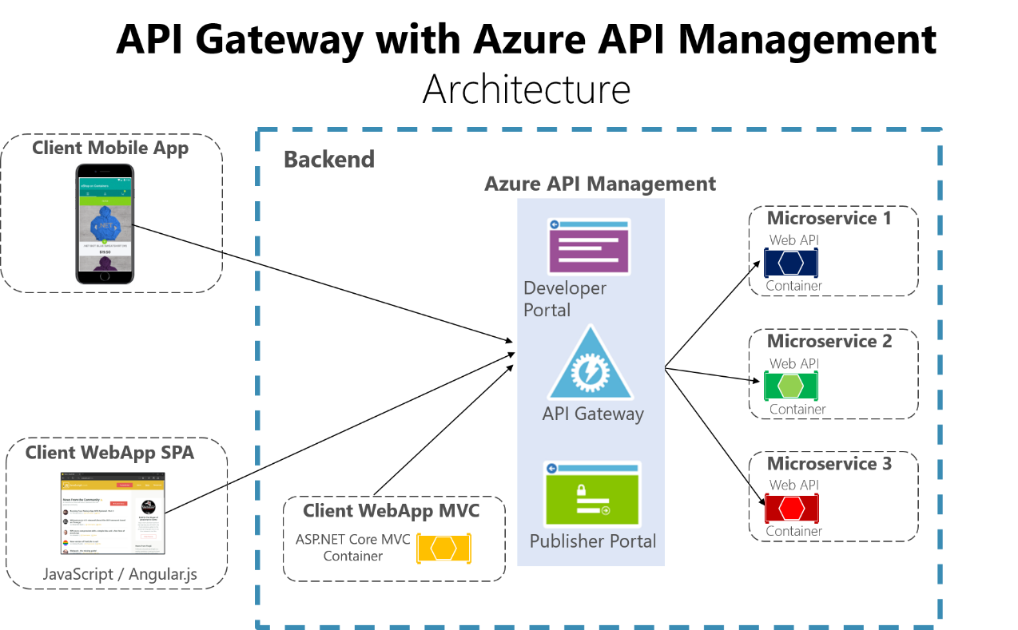
API Gateways
Features
Routing
Request Aggregation
Service Discovery with Consul & Eureka
Service Fabric
Kubernetes
WebSockets
Authentication
Authorisation
Rate Limiting
Caching
Retry policies / QoS
Load Balancing
Logging / Tracing / Correlation
Headers / Query String / Claims Transformation
Custom Middleware / Delegating Handlers
Configuration / Administration REST API
Platform / Cloud Agnostic

Slide 16
gRPC

Slide 17
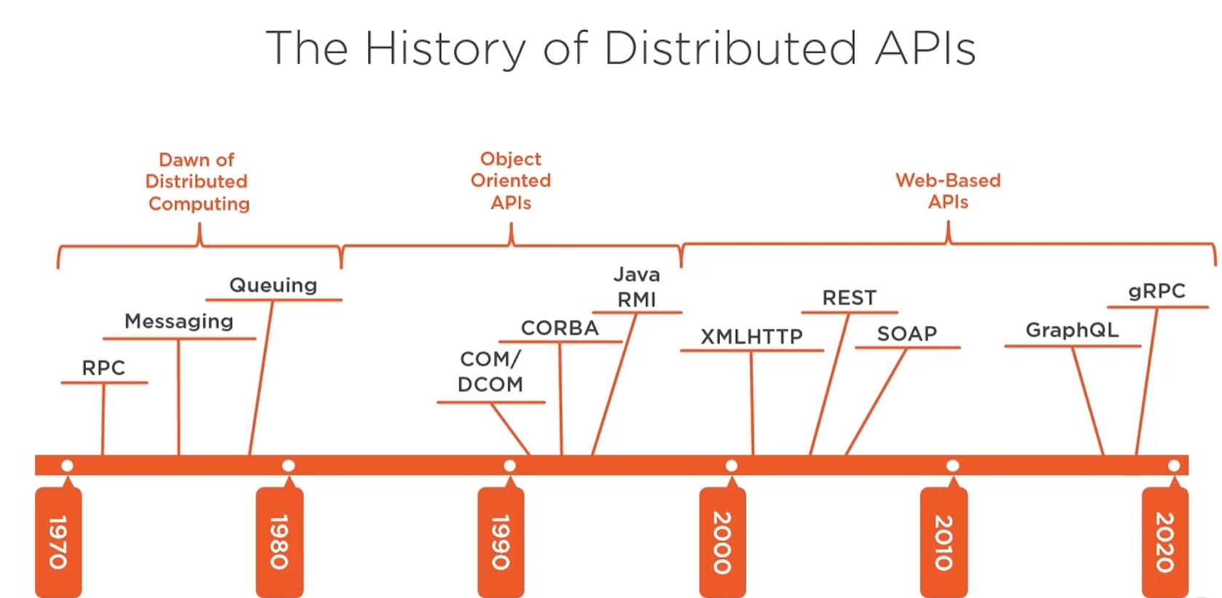

Slide 18
What is gRPC?
Binary communication
Contract-based
Available across ecosystems
Secure by default (requires HTTP/2, TLS, SSL)
Uni and Bi directional streaming
Notes:
One way or two way streaming

Slide 19
gRPC for the Web
HTTP/2 – most browsers don’t suport it yet
Binary format – harder for JS to parse
Required contracts – that’s not so great for Web apps

Slide 20
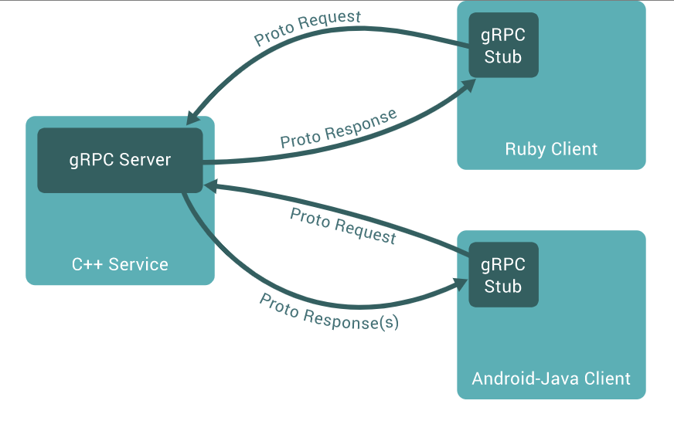
gRPC so where?
IoT
Containers
Service to service communication

Slide 21
Contracts
Generated clients/servers
Uses interface definitione language Protocol Buffers (ProtoBuf)
Language independent
message Person
{
string name = 1;
int32 id = 2;
bool has_ponycopter = 3;
}
https://docs.microsoft.com/en-us/aspnet/core/tutorials/grpc/grpc-start?view=aspnetcore-3.1&tabs=visual-studio

Slide 22
// The greeter service definition.
service Greeter {
// Sends a greeting
rpc SayHello (HelloRequest) returns (HelloReply) {}
}
// The request message containing the user's name.
message HelloRequest {
string name = 1;
}
// The response message containing the greetings
message HelloReply {
string message = 1;
}

Slide 23
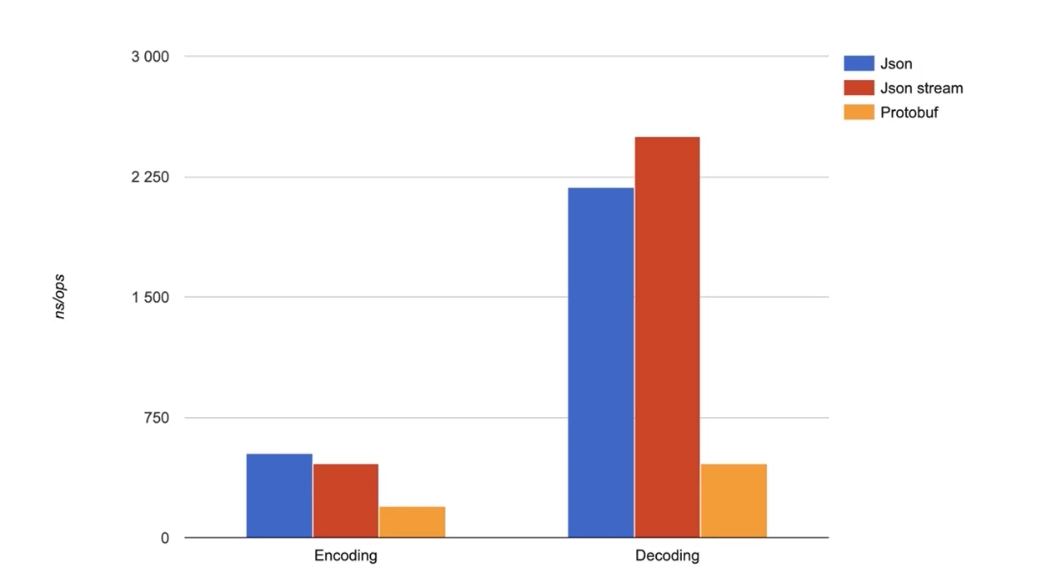
ProtoBuf is fast

Slide 24
Matching communication to technology
REST: CRUD and purely web apps
SignalR: Multicasting and web messaging
GraphQL: Open querying of large datasets
OData: Open querying relational data
gRPC: Streaming, low resource clients, inter- data center
Notes:
https://devblogs.microsoft.com/odata/experimenting-with-odata-in-asp-net-core-3-1/

Slide 25
Closing up

Slide 26
Summary
Basics – REST, ASP.NET Core
Best practices
Security
Testing
Documentation
Limiting
Versioning
Monitoring
API Gateways

Slide 27
Further reading
https://github.com/microsoft/api-guidelines
Specifications
HATEOAS – Hypermedia as the Engine of Application State
https://ionwg.org/ - The ION Hypermedia Type
http://jsonapi.org/ - JSON API Specification
http://json-schema.org/ - JSON (Hyper-)Schema...
http://graphql.org/ - GraphQL
APIs
https://dev.twitter.com/rest/public - Twitter REST
https://developer.github.com/v3/ - GitHub REST / v4 GraphQL
https://stripe.com/docs/api - Stripe
https://www.twilio.com/docs/api/rest - Twilio

Slide 28
Thanks! Questions?

